Slide 1


MediVision AI
~Turning Data into Diagnosis
AI- Powered Medical Imaging Diagnostics
Team NeuroX
  Ansari Fauzan Farooque
  Khan Asjad Shamshad
  Landge Uman Nadeem
  Chorghey Musaddique Mohib
  Ansari Rayyan Khalil

Slide 2
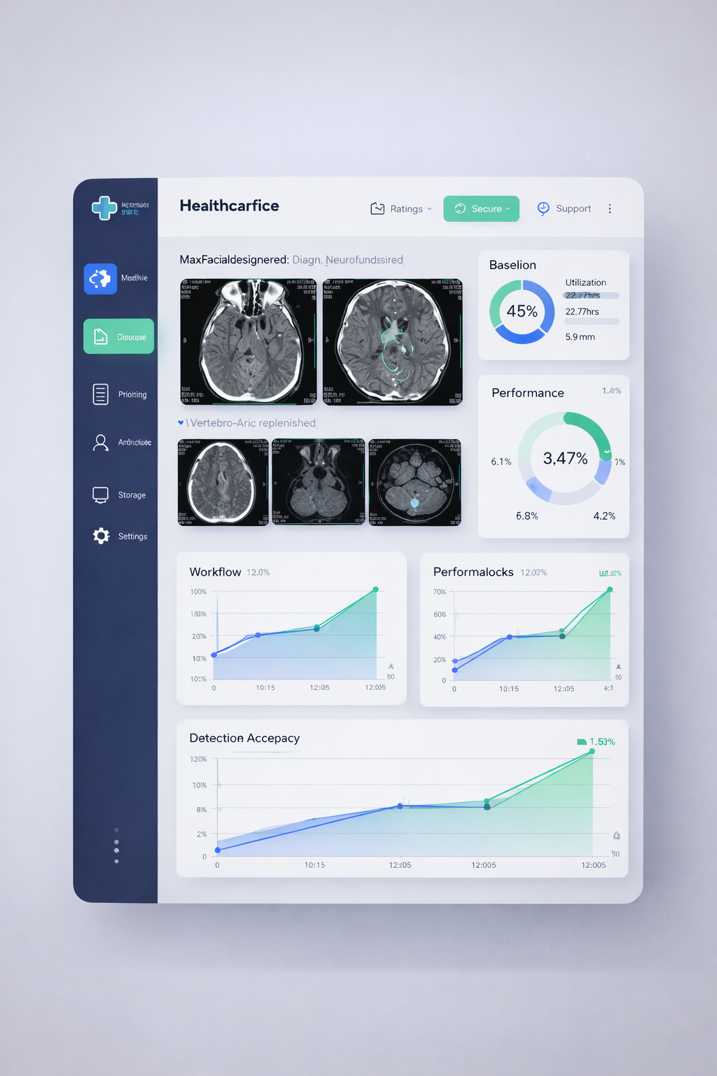
Homepage Overview
The Home Page introduces MediVision AI as an innovative platform focused on transforming healthcare through intelligent medical imaging solutions. It highlights the company’s mission to enhance diagnostic accuracy, improve efficiency, and support healthcare professionals with advanced technology.
The AI medical imaging concept presented on the page explains how artificial intelligence analyzes medical scans such as MRI, CT, and X-ray to detect patterns and abnormalities. By assisting clinicians with faster and more precise image interpretation, the system contributes to early diagnosis and improved patient care.

Slide 3
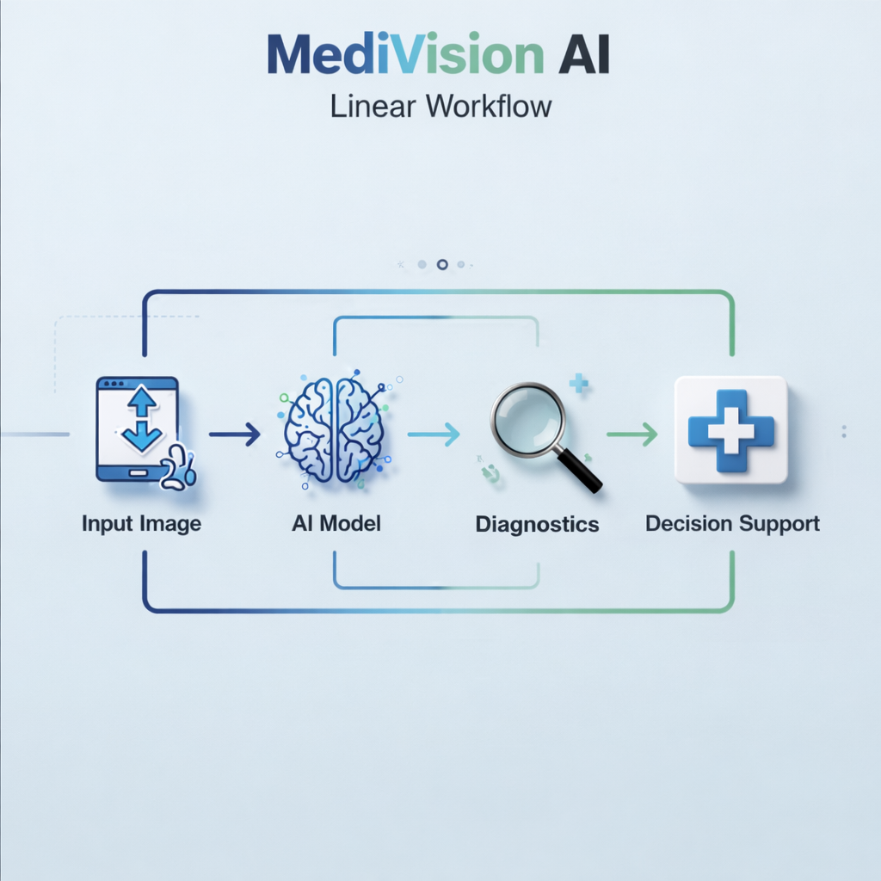
Solution Workflow
The system begins with scan upload, where medical images such as MRI, CT, or X-ray are securely submitted to the platform for analysis. Once uploaded, the AI model processes the image using advanced algorithms trained on large medical datasets.
During AI analysis, the system performs pattern detection to identify abnormalities, risk indicators, or subtle variations that may not be immediately visible. Based on these findings, it generates diagnostic insights and provides clinical recommendations to support informed medical decision-making.

Slide 4
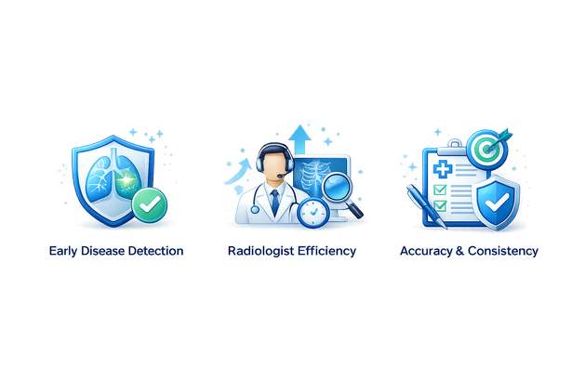

Benefits of MediVision AI
Early Disease Detection
Radiologist Efficiency
Accuracy & Consistency
MediVision AI improves diagnostic accuracy by facilitating early disease detection, enabling healthcare professionals to intervene sooner and enhance patient outcomes through timely treatment and monitoring.
By automating routine analysis, MediVision AI significantly boosts radiologist efficiency, allowing professionals to focus on complex cases and reduce their workload while maintaining high-quality patient care.
The system's advanced algorithms ensure greater accuracy and consistency in imaging diagnostics, minimizing human error and variability, leading to more reliable diagnoses and enhanced trust in medical outcomes.
4

Slide 5
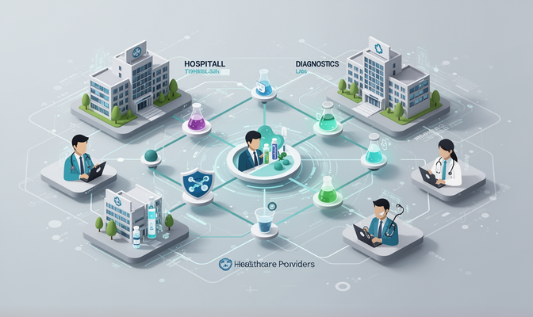



MediVision AI's Business Model and Strategy
Partners
Activities
Collaborating with hospitals and labs nationwide.
Developing AI models for enhanced diagnostics.
Resources
Channels
Utilizing cloud infrastructure for data management.
Integrating solutions through hospital IT systems.

Slide 6
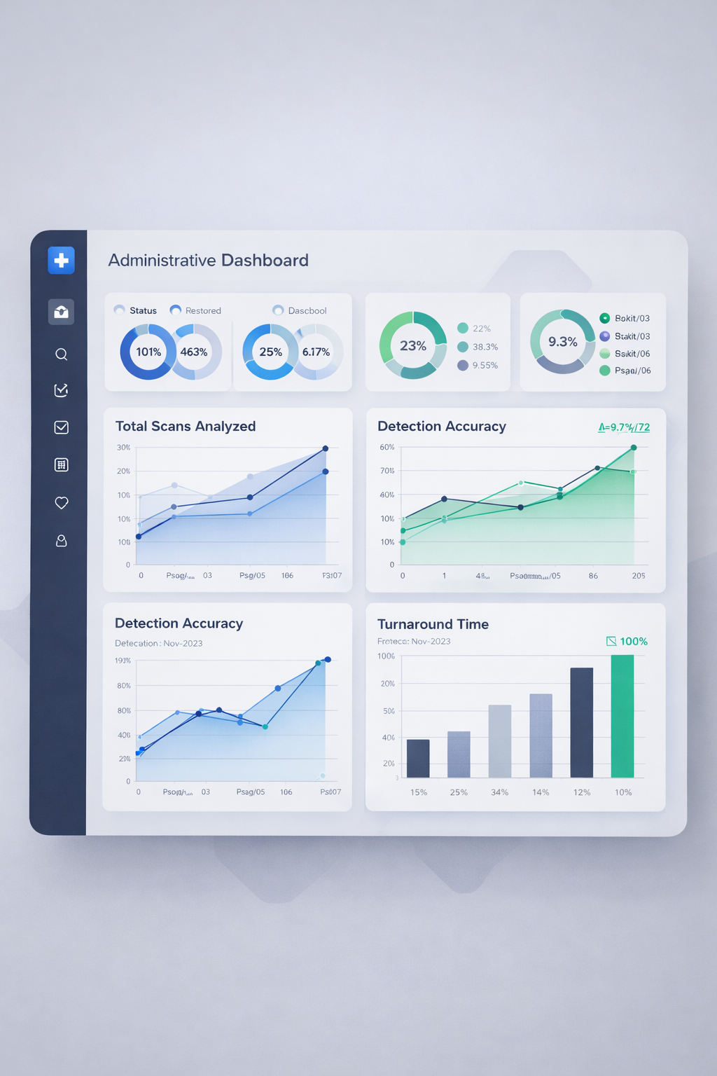
Admin Dashboard & Analytics
The Admin Dashboard provides crucial insights into system performance, tracking metrics such as total scans analyzed, current detection accuracy, and critical findings, enabling healthcare professionals to make informed decisions efficiently.

Slide 7
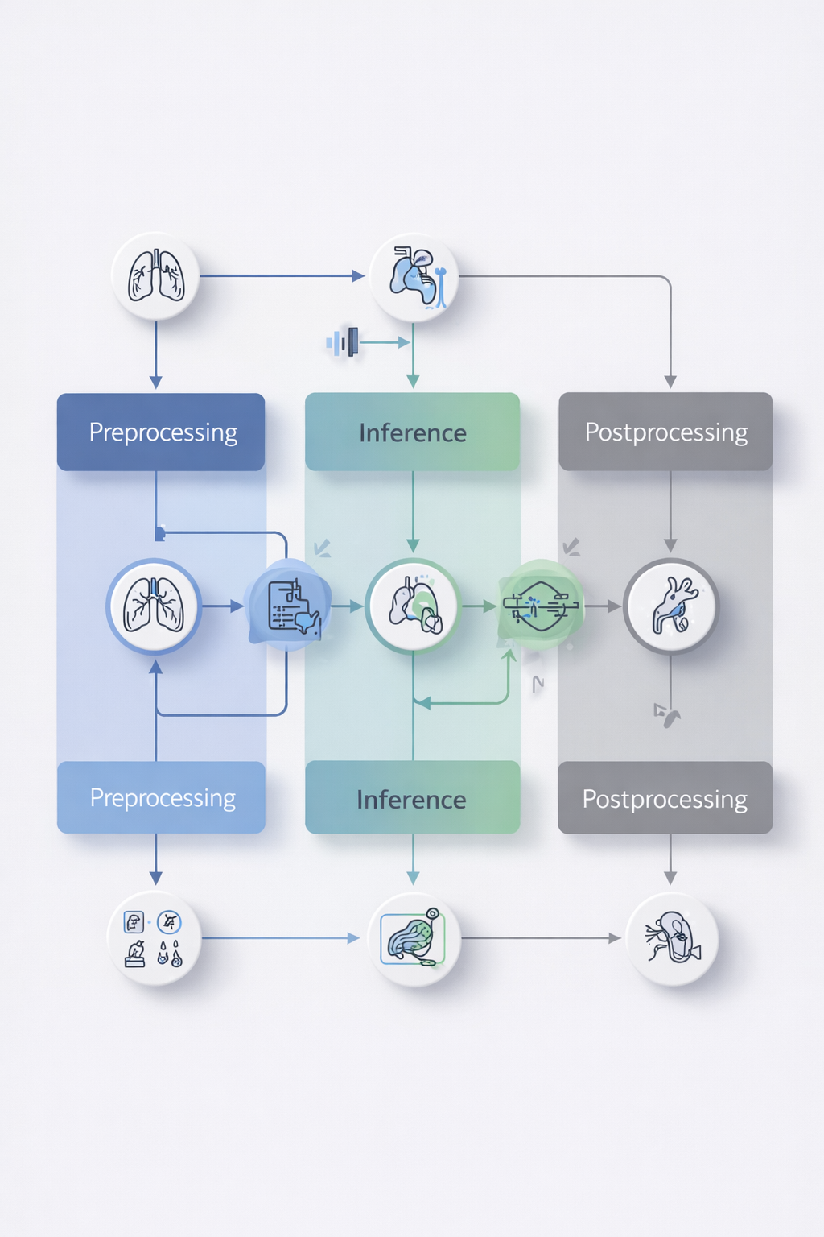
AI Processing Pipeline Overview
AI Analysis in Progress
  AI scans and analyzes medical images in real time
Processing Pipeline
  Preprocessing → Inference → Postprocessing
Report Generation
  Structured report with highlighted findings
Critical Findings Detection
  Flags urgent cases for immediate review

Slide 8
Settings & Usage
User Profile Management
Security & Data Settings
Hospital Integration Readiness
User profile management allows administrators to control roles, permissions, and access levels within the system. It enables personalized dashboards, tracks user activity, and maintains case histories, ensuring accountability and organized workflow management.
Security and data settings ensure that all medical information is protected through encryption and secure storage. Role-based access control restricts sensitive data to authorized personnel only, maintaining confidentiality and compliance with healthcare standards.
The system is designed to integrate smoothly with existing hospital infrastructures such as HIS, RIS, and PACS. With API support and scalable architecture, it allows seamless data exchange across departments and supports large-scale clinical deployment.
Conclusion
AI significantly improves diagnostic workflow by accelerating image analysis and streamlining reporting processes. It reduces medical errors through consistent and data-driven evaluation while supporting healthcare professionals in making faster, more informed clinical decisions.
8

